Slide 1
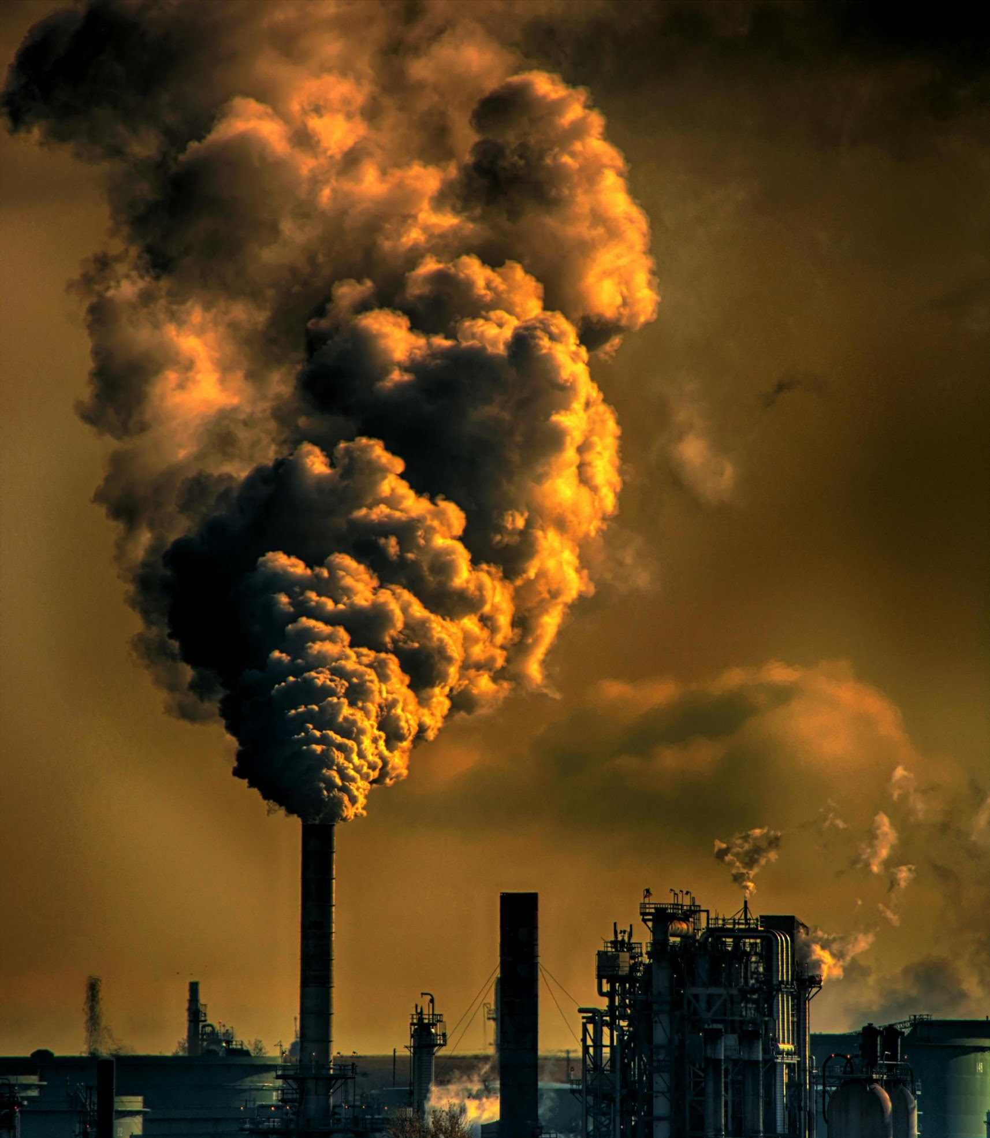
Earth's Environmental Saga: A Survey of Pollution
Name : Mohammad Wasi
Batch : AIML B8
SAP ID : 500110709
Submitted to : Dr Balendu Shekher Giri

Slide 2
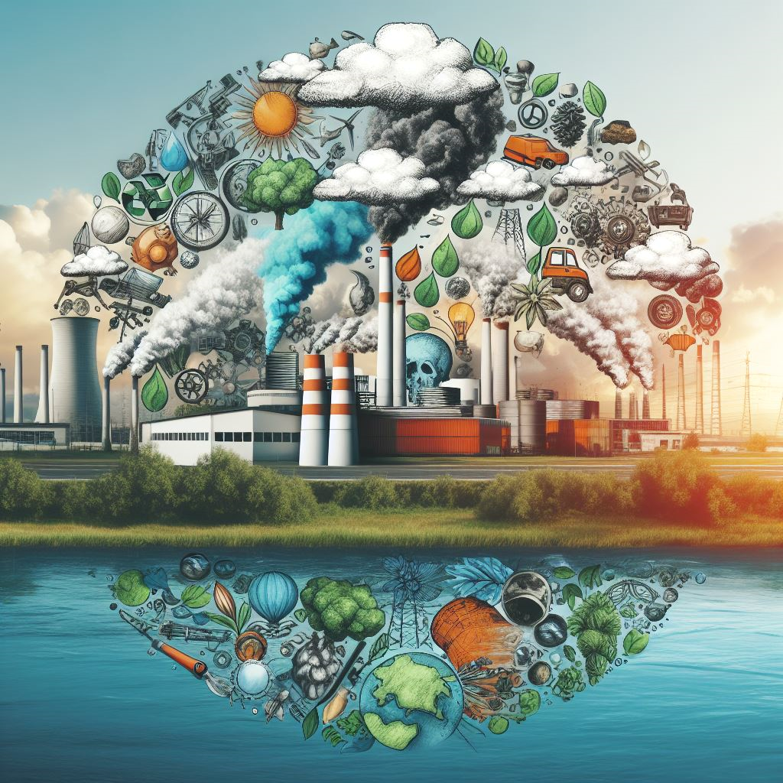
What is Pollution ?
Understanding Pollution
Pollution, a pervasive threat to our planet's well-being, is the introduction of harmful contaminants into the environment. It manifests in various forms, each posing distinct challenges to ecosystems and human health.
Defining Pollution
At its core, pollution encompasses the release of substances or energy into the environment that cause adverse effects. These pollutants can originate from natural sources or human activities, disrupting the natural balance of ecosystems and posing risks to biodiversity and human health.

Slide 3

Types of Pollution
1. Air Pollution:
Primarily driven by emissions from industrial processes, vehicular exhaust, and agricultural activities, air pollution comprises a complex mixture of pollutants such as particulate matter, nitrogen oxides, sulfur dioxide, and volatile organic compounds.
Common sources include factories, power plants, transportation systems, and biomass burning.
Air pollution not only deteriorates air quality but also contributes to respiratory diseases, cardiovascular problems, and climate change.

Slide 4


Types of Pollution
2. Water Pollution:
Water pollution arises from the contamination of water bodies, including rivers, lakes, oceans, and groundwater, by various pollutants such as chemicals, heavy metals, pathogens, and nutrients.
Sources of water pollution include industrial discharges, agricultural runoff, sewage disposal, and oil spills.
Water pollution jeopardizes aquatic ecosystems, compromises drinking water quality, and poses significant health risks to humans and wildlife

Slide 5
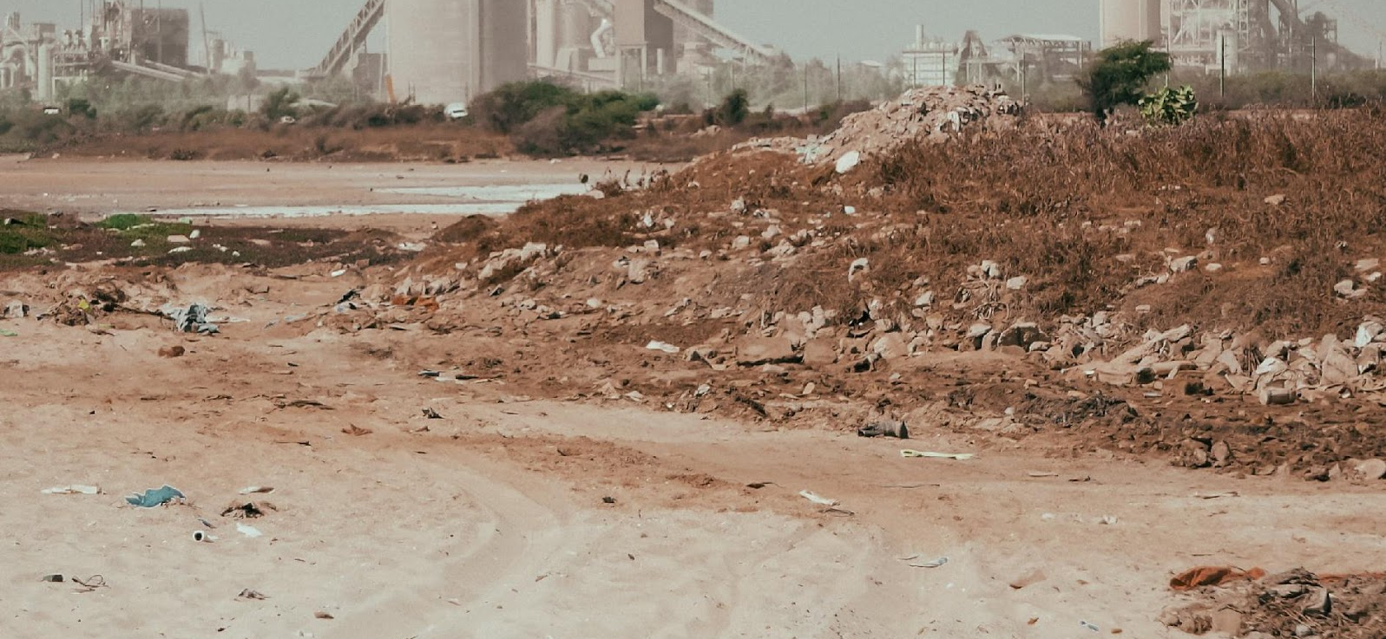
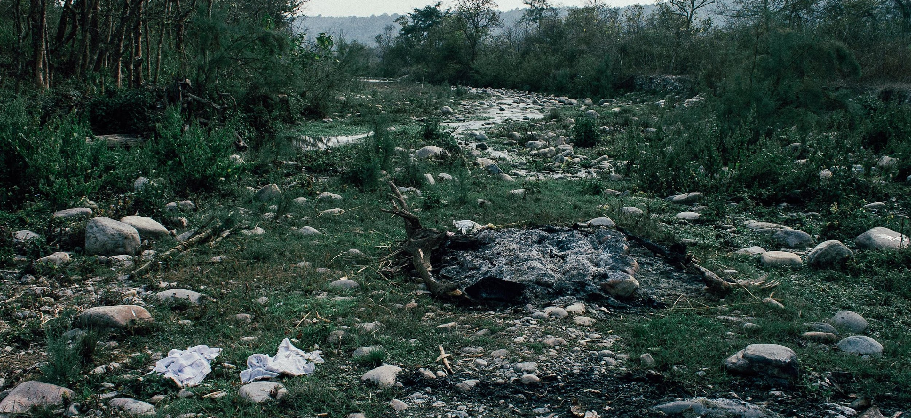
Types of Pollution
Types of Pollution- air, noise, water, soil, municipal solid waste, hazardous waste; Transboundary air pollution; Acid rain; Smog.
3. Soil Pollution:
Soil pollution occurs when soil is contaminated with harmful substances like pesticides, heavy metals, industrial chemicals, and waste disposal.
Activities such as improper waste disposal, industrial processes, mining, and agricultural practices contribute to soil contamination.
Soil pollution impairs soil fertility, reduces crop yields, and poses health risks through the consumption of contaminated food and water.

Slide 6




Types of Pollution
4. Noise Pollution:
Noise pollution results from excessive noise levels in the environment, primarily generated by transportation, industrial activities, construction, and urbanization.
Prolonged exposure to high noise levels can lead to hearing impairment, stress, sleep disturbances, and adverse effects on wildlife.
Noise pollution disrupts natural habitats, communication patterns, and overall quality of life for humans and animals alike.

Slide 7
Historical Perspectives: Evolution of pollution challenges over time.
Historical Perspectives
Throughout history, pollution challenges have evolved alongside human civilization, shaping the environment and impacting societies.
Ancient Civilizations
Early civilizations faced rudimentary pollution challenges, such as waste disposal and deforestation, leading to localized environmental degradation.
Practices like open waste dumping and clearing of forests for agriculture contributed to pollution, albeit on a smaller scale compared to later periods.
Pre-Industrial Era
Pollution remained relatively limited during the pre-industrial era, but began to intensify with early industrial activities like mining, metalworking, and agricultural expansion.

Slide 8
Historical Perspectives: Evolution of pollution challenges over time.
Industrial Revolution
The Industrial Revolution, spanning the 18th and 19th centuries, marked a significant turning point in pollution history.
Rapid industrialization, fueled by coal and steam power, led to widespread pollution from factories, urbanization, and transportation.
Smokestack emissions, untreated sewage, and industrial waste polluted air and waterways, causing environmental degradation and public health crises.
Urbanization and Population Growth
The 20th century witnessed exponential population growth and urbanization, amplifying pollution challenges.
Increasing industrialization, reliance on fossil fuels, and expansion of transportation networks escalated pollution levels, particularly in urban areas.
Cities became centers of pollution, characterized by smog-filled skies, contaminated water sources, and hazardous waste disposal.
Environmental Awareness and Regulation
The latter half of the 20th century saw a rise in environmental awareness and regulatory efforts to address pollution.
Landmark events, such as the publication of Rachel Carson's "Silent Spring" and the establishment of environmental protection agencies, spurred public outcry and policy action.
International agreements and conventions, such as the Kyoto Protocol and the Paris Agreement, underscored the need for global cooperation to combat pollution and mitigate climate change.

Slide 9
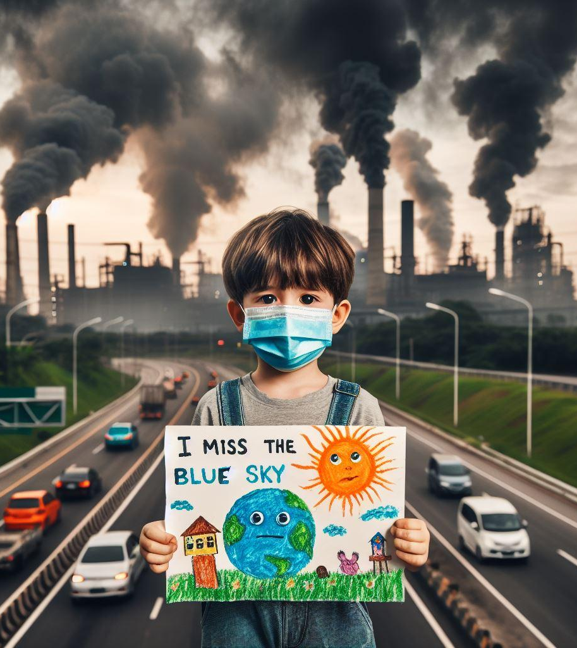
Understanding Air Pollution
Air pollution, a pressing environmental issue, arises from various sources, each contributing to the degradation of air quality and posing risks to human health and the environment.

Slide 10
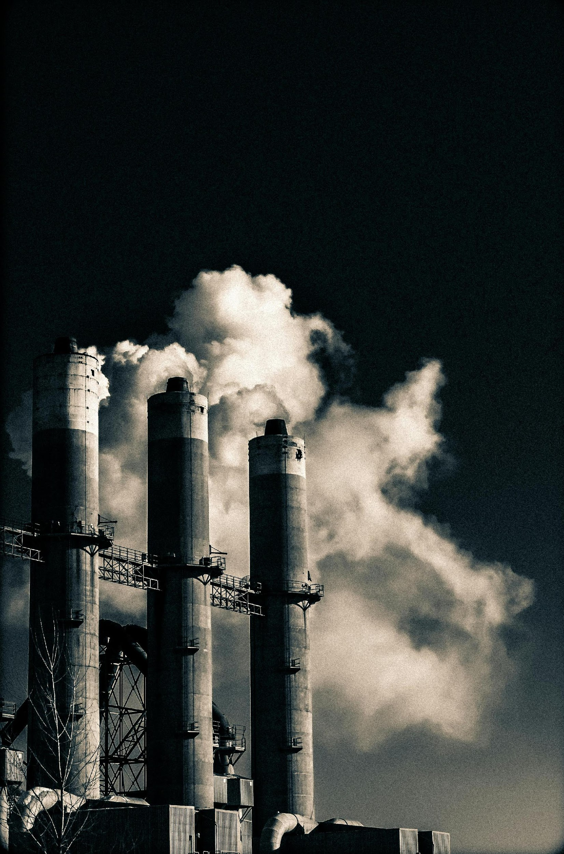
Major Contributors to Air Pollution
Industrial Emissions:
Industries release pollutants such as particulate matter, sulfur dioxide (SO2), nitrogen oxides (NOx), volatile organic compounds (VOCs), and hazardous air pollutants (HAPs) into the atmosphere. These emissions result from manufacturing processes, power generation, and chemical production, contributing significantly to air pollution-related health issues and environmental degradation.
Manufacturing Processes:
Factories and manufacturing facilities emit pollutants during various production processes. These processes often involve the combustion of fossil fuels, such as coal, oil, and natural gas, to power machinery and generate heat.
Combustion releases particulate matter (PM), which consists of tiny solid or liquid particles suspended in the air. These particles can range in size from coarse dust to fine aerosols and can have harmful effects on respiratory health when inhaled.
Manufacturing operations also release sulfur dioxide (SO2) and nitrogen oxides (NOx) into the atmosphere.

Slide 11

Major Contributors to Air Pollution
Construction Activities:
Construction projects, such as building construction, road paving, and demolition activities, also contribute to air pollution.
Dust emissions are a common byproduct of construction activities, particularly during excavation, demolition, and earth-moving operations. These dust particles can contain a variety of pollutants, including particulate matter, silica, and heavy metals.
Diesel-powered construction equipment and machinery also emit nitrogen oxides (NOx) and particulate matter (PM) into the air, contributing to localized air pollution in construction sites and surrounding areas.

Slide 12
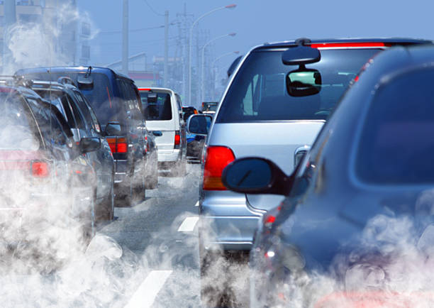
Major Contributors to Air Pollution
Transportation:
The transportation sector is a cornerstone of modern society, enabling the movement of people and goods across vast distances. However, this convenience comes at a cost to air quality, as transportation activities are a significant source of air pollution. Let's explore in more detail how various modes of transportation contribute to air pollution:
Road Vehicles (Cars, Trucks, Buses):
Road vehicles powered by internal combustion engines are major contributors to air pollution, particularly in urban areas with high traffic density.
Combustion engines in these vehicles burn fossil fuels, such as gasoline and diesel, to generate power. This combustion process releases a variety of pollutants into the air, including:
Carbon Monoxide (CO): A colorless, odorless gas produced by incomplete combustion of fossil fuels. CO can impair the body's ability to transport oxygen and is particularly harmful in enclosed spaces.
Nitrogen Oxides (NOx): These pollutants form when nitrogen and oxygen react under high temperatures during combustion. NOx contributes to the formation of ground-level ozone and smog, which can irritate the respiratory system and exacerbate respiratory conditions.
Hydrocarbons (HCs): Organic compounds emitted during fuel combustion contribute to the formation of ground-level ozone and smog. HCs can also react with nitrogen oxides to form secondary pollutants.

Slide 13

Major Contributors to Air Pollution
Airplanes:
Aircraft engines, particularly those used in commercial airliners, emit pollutants during takeoff, cruising, and landing phases of flight.
Jet engines combust aviation fuel, releasing pollutants such as nitrogen oxides (NOx), sulfur oxides (SOx), carbon monoxide (CO), and particulate matter (PM) into the atmosphere.
Emissions from aircraft contribute to air pollution near airports and along flight paths, impacting air quality in surrounding communities and regions.

Slide 14

Major Contributors to Air Pollution
Agricultural Activities:
Agricultural practices, including livestock farming, crop burning, and fertilizer use, contribute to air pollution through the release of ammonia (NH3), methane (CH4), and nitrous oxide (N2O). These emissions result from livestock waste management, rice paddies, and fertilizer application, exacerbating greenhouse gas concentrations and air quality concerns, particularly in rural areas.

Slide 15
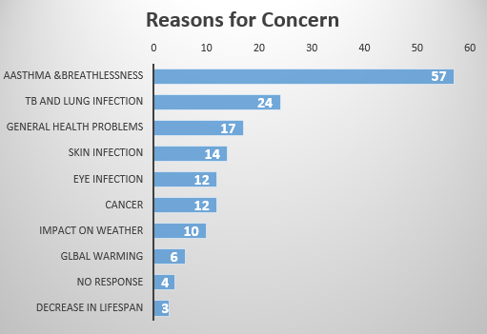
Effects on Human Health and Ecosystems
The health costs of air pollution in India are staggering, with significant impacts on respiratory health, cardiovascular diseases, and overall mortality rates. Asthma, exacerbated by air pollution, stands as the primary health concern, accounting for over 50% of health problems linked to poor air quality. Exposure to pollutants like particulate matter (PM), sulfur dioxide (SO2), and nitrogen oxides (NOx) over time leads to a myriad of health issues, including bronchitis, chronic obstructive pulmonary disease (COPD), lung cancer, and heart attacks.
According to the Global Burden of Disease Study, outdoor air pollution was the fifth-largest killer in India in 2010, contributing to approximately 620,000 premature deaths. Alarmingly, over a million Indians die prematurely every year due to air pollution, with children bearing a significant burden, as evidenced by abnormalities in lung function observed in half of Delhi's children.

Slide 16
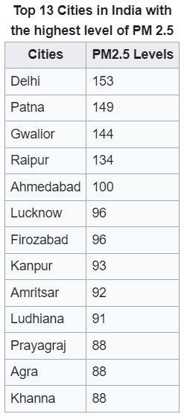
Effects on Human Health and Ecosystems
Moreover, air pollution has adverse effects on life expectancy, with estimates suggesting that limiting exposure to national air quality recommendations could increase average life expectancy in India by 1.7 years.
In addition to its human health impacts, air pollution also takes a toll on biodiversity and ecosystems. India is home to some of the most polluted cities globally, with 14 out of the 15 most polluted cities in terms of PM2.5 concentrations. This pollution exacerbates respiratory and cardiovascular conditions, leading to increased hospital visits and exacerbating disease burdens, particularly in rural areas where reliance on solid biomass for cooking further worsens air quality.
Despite efforts to mitigate pollution, India continues to struggle with exceeding air quality targets and violations. While some cities show improvement, challenges persist, with pollution levels worsening during winter months and exacerbating health burdens, particularly in cities like Delhi, Kolkata, and Mumbai.
Overall, the data underscores the urgent need for comprehensive measures to tackle air pollution in India, including stricter regulations, adoption of cleaner technologies, and promotion of sustainable practices to protect public health and preserve the environment.

Slide 17

Government Initiatives and Future Goals
Action Taken to Combat Air Pollution
The government in Delhi initiated the Odd-Even Rule in November 2017, employing an innovative rationing method where vehicles with odd-numbered plates were allowed on certain days, while even-numbered plates were permitted on alternate days.
Local administrations across various states have implemented stringent measures, including enforcing tighter vehicle emissions norms, imposing higher penalties for waste burning, and enhancing road dust control.
The Indian government has committed to a substantial reduction in households using solid fuel for cooking, aiming for a 50% reduction in reliance on traditional cooking methods.
Reducing Carbon Emissions: Implement measures to reduce carbon emissions in line with international climate targets, aiming for a significant decline in CO2 emissions by 2030 and achieving net zero emissions by designated timelines to limit global warming.

Slide 18

Government Initiatives and Future Goals
Future Goals:
Clean up the transportation sector by introducing 1,000 electric public transport buses alongside existing fleets, promoting a shift towards eco-friendly commuting options.
Upgrade all fossil fuel combustion engine vehicles to comply with
Aim to have 25% of private vehicles powered by electricity by 2023, fostering the adoption of sustainable and emission-free transportation alternatives.
Implement renewable energy initiatives across all power plants, transitioning towards cleaner energy sources and reducing reliance on fossil fuels.
Provide farmers with innovative solutions like the Happy Seeder machine to convert agricultural residue into fertilizer, tackling the problem of crop burning and its associated air pollution.
Encourage crop diversification among farmers, promoting the cultivation of water-conserving crops like coarse grains and pulses to mitigate environmental impacts and enhance sustainability.
Conduct extensive health data analysis and evaluate the efficiency of various room filtration systems in areas with high indoor air pollution levels, ensuring public health protection.
Launch citizen science programs to empower communities in documenting air pollution exposures effectively, fostering public awareness and engagement in combating air pollution.

Slide 19

Understanding Noise Pollution
Noise pollution isn't just an annoyance; it's a pervasive environmental concern that affects our health and well-being. Delving into the cacophony of sounds that surround us unveils a complex symphony of noise pollution, composed of various sources and unique characteristics. Let's take a closer look at the dynamic elements shaping this environmental challenge:

Slide 20
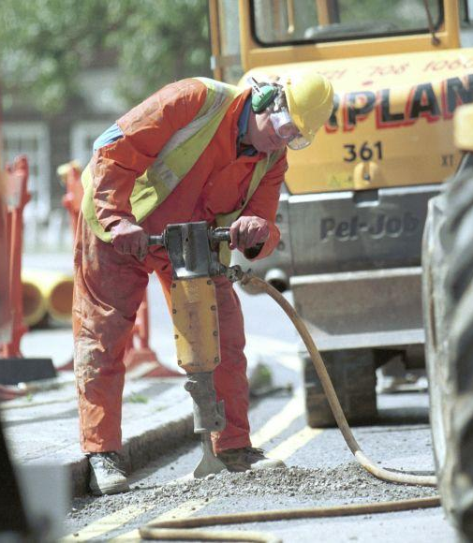
Major Contributors to Noise Pollution
Sources of Noise Pollution:
Traffic: Roads bustling with vehicles contribute significantly to noise pollution. The continuous honking, engine noises, and tire friction generate constant noise levels, especially in urban areas.
Industry: Industrial activities such as manufacturing, construction, and processing plants produce high levels of noise pollution. Machinery, equipment, and heavy vehicles operating in industrial zones contribute to the overall noise levels in surrounding areas.
Commercial Establishments: Commercial activities in areas like markets, shopping centers, and entertainment venues add to noise pollution. Music, announcements, and crowd noises from these establishments can reach high decibel levels, especially during peak hours.
Construction Sites: Construction activities involve heavy machinery, drilling, and hammering, generating significant noise pollution. Construction sites often operate in residential or urban areas, amplifying the disturbance caused by the noise.

Slide 21

Characteristics of Noise Pollution:
Decibel Levels: Noise pollution is measured in decibels (dB), with higher dB levels indicating louder sounds. Common sources such as traffic and industry can produce noise levels ranging from 70 dB to over 100 dB, exceeding safe thresholds for human comfort and health.
Frequency and Pitch: Noise pollution varies in frequency and pitch, with some sources emitting low-frequency rumbling noises while others produce high-pitched sounds. The frequency and pitch of noise can influence its impact on human hearing and overall annoyance levels.
Duration and Intensity: Noise pollution can be intermittent or continuous, with varying intensities throughout the day. Prolonged exposure to high-intensity noise can lead to hearing loss, stress, and other adverse health effects.
Spatial Distribution: Noise pollution spreads spatially from its source, affecting surrounding areas based on factors such as distance, terrain.

Slide 22
Health Impacts of Noise Pollution: Insights from Research
Noise pollution isn't just a nuisance; it's a significant threat to public health, with studies consistently linking noise exposure to various adverse health outcomes. Let's explore the findings of research that have unraveled the intricate connections between noise pollution and its impacts on human health:
Cardiovascular Effects: Numerous studies have established a clear association between chronic exposure to noise pollution and cardiovascular diseases. The constant barrage of noise triggers stress responses in the body, leading to elevated blood pressure, increased heart rate, and heightened risk of heart attacks and strokes.
Sleep Disturbances: Noise pollution disrupts our natural sleep patterns, leading to sleep disturbances and insomnia. Research has shown that even low-level noise can interfere with sleep quality, causing fragmented sleep, decreased REM sleep, and increased daytime drowsiness, ultimately impacting overall health and well-being.
Cognitive Impairments: Prolonged exposure to noise pollution has been linked to cognitive impairments and decreased cognitive performance. Studies have found that noise can impair concentration, memory, and learning abilities, particularly in children and older adults, affecting academic performance and cognitive development.
Mental Health Concerns: Noise pollution takes a toll on mental health, contributing to increased stress, anxiety, and depression. Research has shown that individuals living in noisy environments experience higher levels of psychological distress and reduced quality of life, highlighting the profound impact of noise pollution on mental well-being.
Hearing Loss: Occupational exposure to high levels of noise is a well-established risk factor for hearing loss. However, even environmental noise at lower levels can lead to permanent hearing damage over time. Studies have demonstrated a clear correlation between noise exposure and hearing loss, emphasizing the importance of protecting our ears from excessive noise levels.
Adverse Birth Outcomes: Emerging research suggests that noise pollution may also impact pregnancy outcomes, with maternal exposure to noise linked to adverse birth outcomes such as low birth weight, preterm birth, and developmental delays in infants. These findings underscore the importance of minimizing noise exposure during pregnancy to support maternal and fetal health.

Slide 23

Innovative Strategies for Urban Noise Reduction
Engineering Solutions: Employing engineering controls to diminish noise propagation and safeguard individuals from excessive exposure. This includes implementing noise-reducing technologies and structures such as sound barriers along roadways.
Personal Protection: Encouraging individuals to protect themselves from noise pollution by using hearing protection such as earplugs or earmuffs, especially in noisy environments or during high-exposure activities.
Buy Quiet Initiatives: Promoting the purchase and use of quieter equipment and tools in workplaces and industries to reduce occupational noise exposure. This initiative encourages manufacturers to design and produce quieter machinery.
Urban Planning and Design: Integrating noise mitigation measures into urban planning and roadway design. Strategies include limiting vehicle speeds, implementing traffic controls to smooth vehicle flow, and utilizing quieter roadway surface textures.
Roadway Noise Management: Utilizing computer models to analyze and address roadway noise, considering factors like local topography, traffic patterns, and potential mitigation solutions during the planning stages of roadway projects.
Aircraft Noise Reduction: Implementing measures to reduce aircraft noise, such as using quieter jet engines and optimizing flight paths and runway schedules to minimize noise impact on surrounding communities.

Slide 24
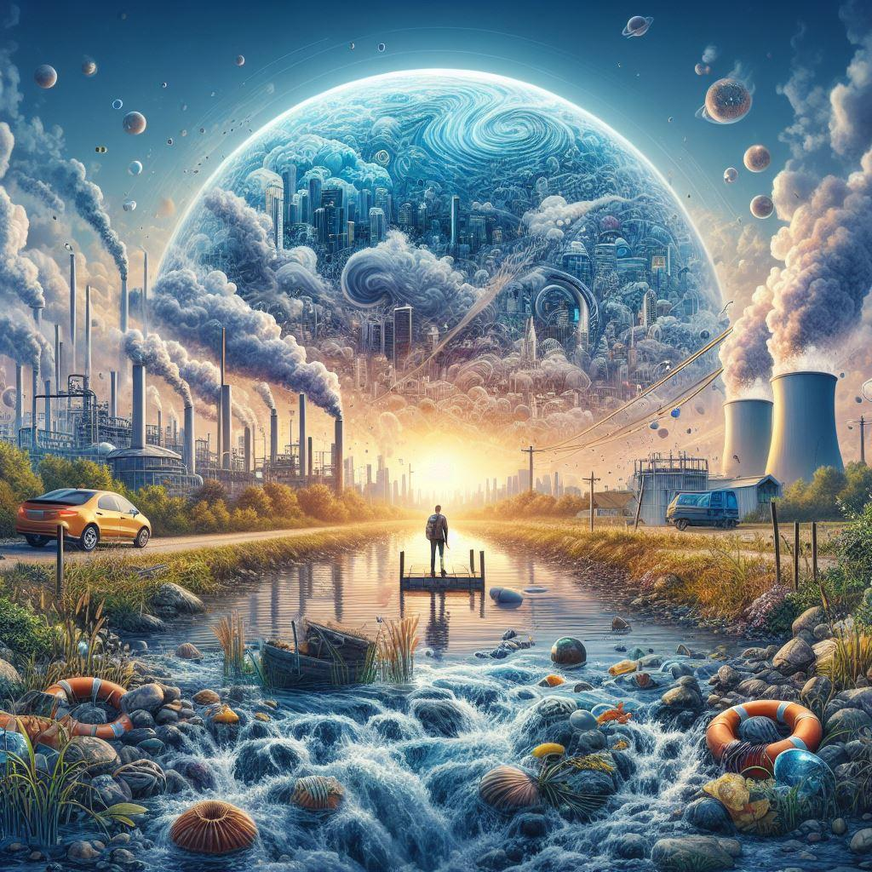
Understanding Water Pollution
Water pollution poses a significant threat to ecosystems and human health worldwide. Understanding the causes and contaminants behind water pollution is essential for effective mitigation strategies.

Slide 25
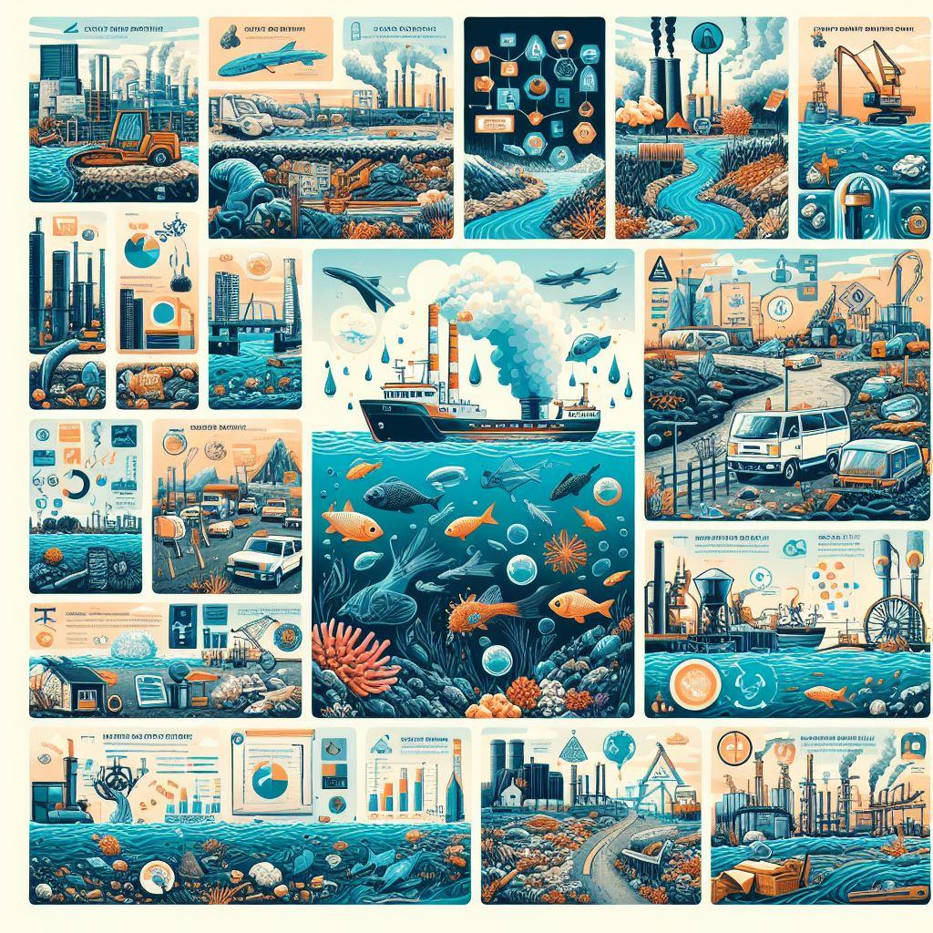
Causes of Water Pollution
Industrial Discharges: Industries release various pollutants into water bodies, including heavy metals, chemicals, and toxins. Industrial wastewater containing pollutants like mercury, lead, and arsenic can contaminate water sources and disrupt aquatic ecosystems.
Agricultural Runoff: Agricultural activities contribute to water pollution through the runoff of fertilizers, pesticides, and herbicides from farmlands. These chemicals can leach into nearby water bodies, leading to nutrient pollution, algal blooms, and ecosystem degradation.
Urbanization: Rapid urban development leads to increased impervious surfaces and stormwater runoff, carrying pollutants such as oil, grease, and debris into waterways. Urban runoff can introduce contaminants into rivers, lakes, and coastal areas, compromising water quality and habitat integrity.
Sewage and Wastewater: Improperly treated sewage and wastewater discharge introduce pathogens, nutrients.

Slide 26
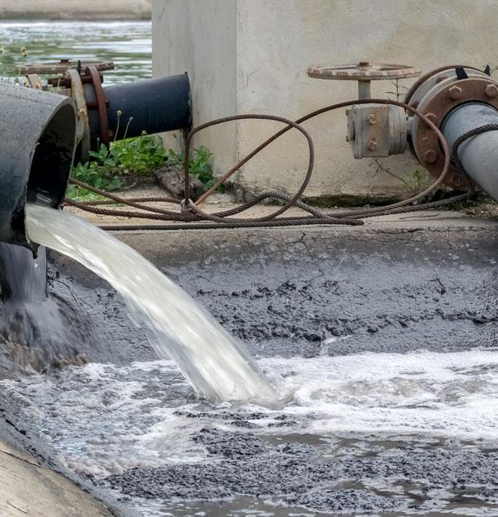
Contaminants in Water Pollution:
Chemical Pollutants: Water pollution includes a wide range of chemical contaminants, such as heavy metals (mercury, lead, cadmium), pesticides (DDT, glyphosate), industrial chemicals (PCBs, dioxins), and pharmaceuticals (antibiotics, hormones). These chemicals can have toxic effects on aquatic organisms and biomagnify through the food chain, posing risks to human health.
Microplastics: Microplastics, tiny plastic particles less than 5 mm in size, have emerged as a significant pollutant in aquatic environments. These microplastics originate from the breakdown of larger plastic debris, microbeads in personal care products, and synthetic fibers from textiles. Microplastics can adsorb toxic chemicals and act as vectors for pollutants, threatening marine life and human health.

Slide 27
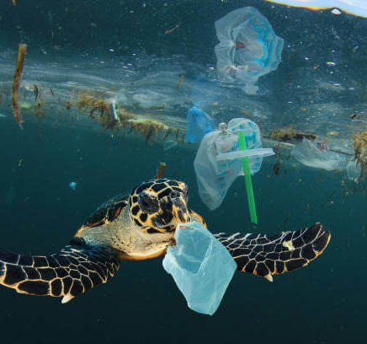
Impact on Aquatic Life and Human Health:
Water pollution exacts a toll not only on aquatic ecosystems but also on human health. Understanding the impact on both aquatic life and human well-being is crucial for addressing this pressing environmental issue.
Decline in Fish Populations:
Ecosystem Disruption: Water pollution disrupts aquatic habitats, leading to a decline in fish populations. Pollutants such as heavy metals, pesticides, and nutrients can impair fish reproduction, growth, and survival, destabilizing entire aquatic food webs.
Bioaccumulation and Biomagnification: Pollutants accumulate in fish tissues through a process called bioaccumulation, wherein toxins build up over time. Additionally, pollutants can magnify through the food chain via biomagnification, posing risks to predators at higher trophic levels, including humans.
Loss of Biodiversity: Water pollution contributes to the loss of biodiversity in aquatic ecosystems, as sensitive species succumb to pollution-related stressors. The decline in fish populations has cascading effects on ecosystem functioning, including reduced resilience to environmental disturbances and impaired ecosystem services.

Slide 28
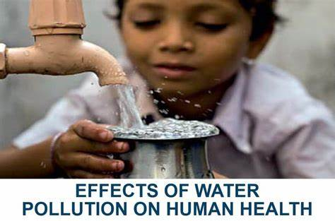
Impact on Human Health
Waterborne Diseases:
Pathogen Contamination: Water pollution introduces pathogenic microorganisms such as bacteria, viruses, and parasites into water sources, increasing the risk of waterborne diseases. Contaminated water poses a significant threat to public health, leading to outbreaks of diarrheal diseases, gastrointestinal infections, and other waterborne illnesses.
Public Health Impacts: Waterborne diseases disproportionately affect vulnerable populations, including children, the elderly, and individuals with compromised immune systems. Inadequate sanitation and access to clean water exacerbate the spread of waterborne diseases, contributing to morbidity and mortality worldwide.
Economic Burden: Waterborne diseases impose a substantial economic burden on healthcare systems and communities, resulting in increased healthcare costs, lost productivity, and diminished quality of life. The prevention and control of waterborne diseases require investments in water infrastructure, sanitation facilities, and public health interventions.

Slide 29
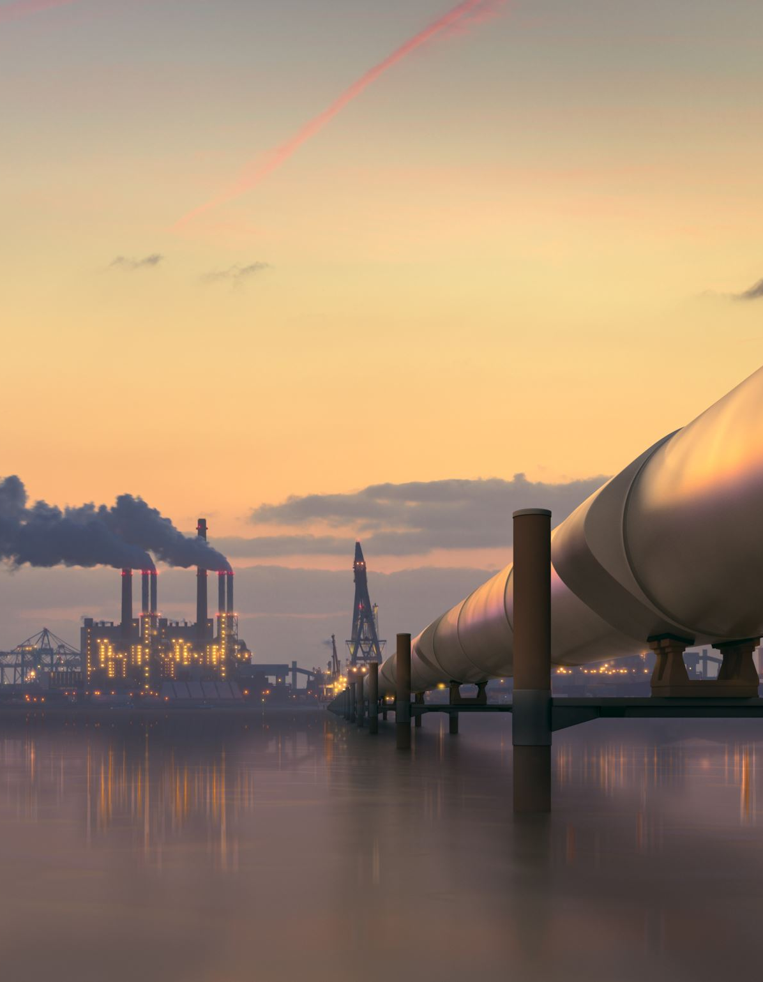
Government Initiatives to Prevent Water Pollution:
Regulations: Enforce water quality standards and limit pollutant discharges.
Monitoring: Implement monitoring programs to track pollution sources and levels.
Wastewater Treatment: Invest in treatment infrastructure to clean sewage and industrial effluents.
Stormwater Management: Utilize strategies to prevent runoff pollution during rainfall.
Agricultural Best Practices: Promote techniques to minimize farm runoff and pesticide contamination.
Pollution Prevention Programs: Incentivize industries to adopt cleaner production methods.
Public Awareness: Conduct campaigns to educate citizens about water conservation and pollution.
International Collaboration: Engage in cooperation to address transboundary water pollution.

Slide 30
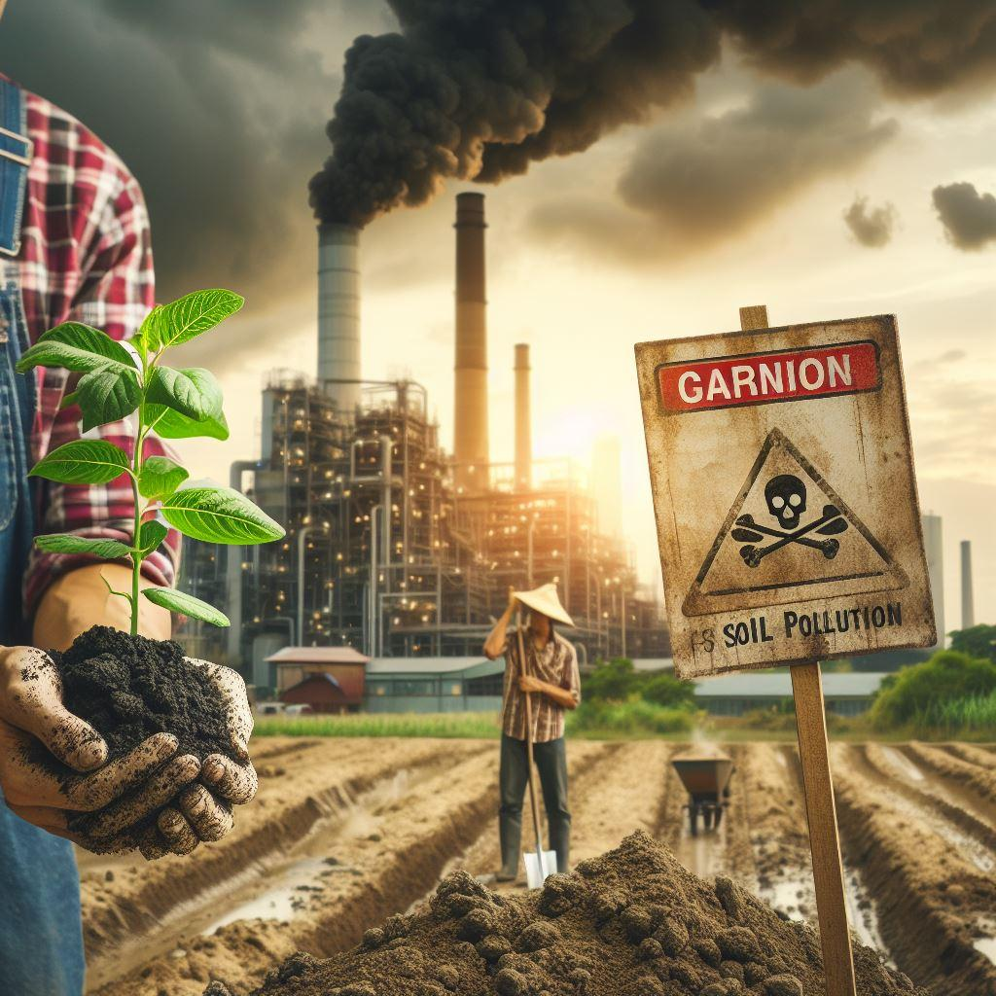
Understanding Soil Pollution
Soil pollution is a pressing environmental concern that poses significant risks to ecosystems and human health. Understanding the contaminants and extent of soil degradation is crucial for effective remediation and conservation efforts.

Slide 31
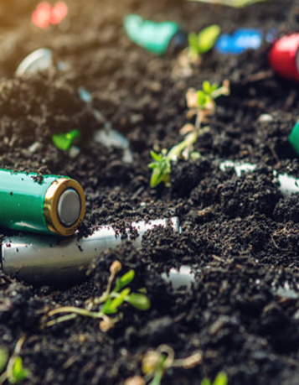
Contaminants in Soil Pollution:
Heavy Metals: Soil contamination by heavy metals such as lead, mercury, cadmium, and arsenic is a widespread issue, primarily originating from industrial activities, mining, and improper waste disposal. These toxic metals accumulate in soil over time, posing risks to plant growth, soil microbial communities, and human health through food chain transfer.
Pesticides and Herbicides: Agricultural practices contribute to soil pollution through the use of pesticides and herbicides to control pests and weeds. Residual chemicals from agricultural runoff and improper application practices can contaminate soil, leading to soil erosion, loss of biodiversity, and groundwater contamination.
Petroleum Hydrocarbons: Soil contamination by petroleum hydrocarbons from oil spills, fuel leaks, and industrial activities poses significant environmental and health risks. These hydrocarbons can persist in soil for extended periods, inhibiting plant growth, contaminating groundwater, and disrupting soil microbial activity.
Industrial Chemicals: Industrial pollutants such as polychlorinated biphenyls (PCBs), polycyclic aromatic hydrocarbons (PAHs), and volatile organic compounds (VOCs) contribute to soil pollution through improper disposal practices and industrial accidents. These chemicals can persist in soil, posing long-term risks to ecosystem health and human well-being.

Slide 32
Extent of Soil Contamination:
Global Impact: Soil contamination affects regions worldwide, with varying degrees of severity depending on industrialization levels, land use practices, and regulatory oversight. Industrialized regions and urban areas often experience higher levels of soil pollution due to concentrated industrial activities and population density.
Localized Hotspots: Soil contamination may occur as localized hotspots, where pollution levels exceed safe thresholds due to historical industrial activities, waste disposal sites, or agricultural practices. These hotspots pose risks to nearby communities and ecosystems, requiring targeted remediation efforts to mitigate contamination.

Slide 33

Soil Pollution: Agricultural Practices and Industrial Contributions
Soil pollution is a significant environmental concern resulting from various human activities, particularly agricultural practices and industrial activities. Understanding the impact of agricultural practices and industrial contributions on soil pollution is essential for implementing effective mitigation strategies.
Agricultural Chemical Usage:
Pesticides and Herbicides: The widespread use of pesticides and herbicides in agriculture contributes to soil pollution. These chemicals are applied to crops to control pests, weeds, and diseases, but their residues can persist in the soil, contaminating groundwater and affecting soil health.
Fertilizers: Agricultural fertilizers contain nutrients such as nitrogen, phosphorus, and potassium, which are essential for plant growth. However, excessive or improper use of fertilizers can lead to soil pollution through nutrient runoff and leaching, causing eutrophication of water bodies and soil degradation.

Slide 34
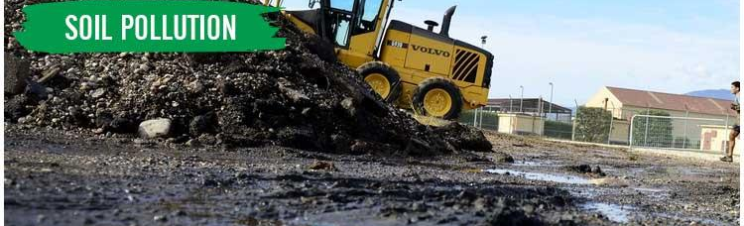
Industrial Waste Data:
Chemical Contamination: Industries generate various types of waste, including chemical by-products, heavy metals, and toxic substances, which can contaminate soil and groundwater. Improper disposal of industrial waste, such as dumping or leaching, poses risks of soil pollution and long-term environmental damage.
Hazardous Materials: Industrial activities produce hazardous materials such as solvents, petroleum products, and heavy metals, which can pose serious risks to soil quality and human health if released into the environment. Spills, leaks, and accidents involving hazardous materials can lead to soil contamination and require remediation efforts.

Slide 35
Programs Promoting Sustainable Soil Management:
Soil Conservation Districts:
These districts provide technical assistance, education, and outreach programs to farmers, landowners, and communities to promote soil conservation practices.
They offer resources such as soil health assessments, erosion control measures, and conservation planning to improve soil quality and productivity.
Cover Crop Initiatives:
Cover crop initiatives incentivize farmers to plant cover crops during fallow periods to protect soil from erosion, suppress weeds, and enhance soil fertility.
These programs offer financial incentives, technical support, and educational resources to encourage the adoption of cover cropping practices.
Soil Health Assessment Programs:
Soil health assessment programs provide farmers with tools and resources to evaluate the physical, chemical, and biological properties of their soils.
Through soil testing, nutrient management planning, and soil health monitoring, farmers can make informed decisions to improve soil health and productivity.
Crop Rotation and Diversification Programs:
Crop rotation and diversification programs promote the use of diverse crop rotations to break pest and disease cycles, improve soil structure, and enhance nutrient cycling.
These programs provide guidance on selecting appropriate crop rotations, integrating legumes and cover crops, and optimizing agronomic practices for sustainable soil management.
Soil Carbon Sequestration Initiatives:
Soil carbon sequestration initiatives aim to enhance soil organic carbon storage to mitigate climate change and improve soil health.
These programs encourage practices such as agroforestry, composting, and organic farming to increase soil carbon levels and promote long-term soil sustainability.

Slide 36
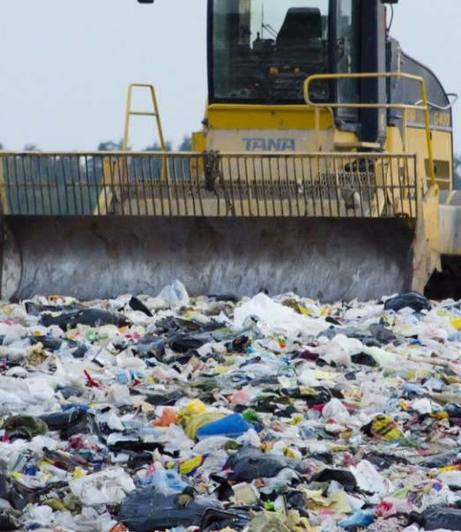
Understanding Municipal Solid Waste
Municipal solid waste (MSW) management is a critical aspect of urban sustainability, encompassing the collection, transportation, disposal, and recycling of waste generated by households, businesses, and institutions. Understanding the composition and generation of MSW is essential for developing effective waste management strategies and promoting resource conservation.

Slide 37
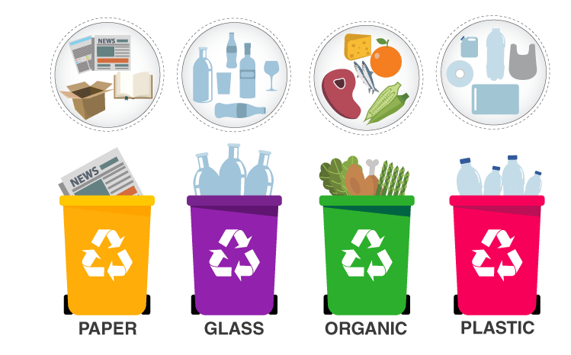
Composition of Municipal Solid Waste:
Organic Waste:
Food Scraps: Leftover food and kitchen waste constitute a significant portion of MSW, including fruit and vegetable peels, spoiled food, and food packaging.
Yard Waste: Grass clippings, leaves, branches, and other organic materials generated from lawn and garden maintenance activities contribute to MSW composition.
Paper and Cardboard:
Packaging Materials: Cardboard boxes, paper packaging, newspapers, magazines, and office paper are common components of MSW, reflecting the widespread use of paper-based products.
Printed Materials: Flyers, advertisements, catalogs, and mail contribute to the paper waste stream, adding to the volume of MSW generated.
Plastics:
Single-Use Plastics: Disposable products such as plastic bags, bottles, containers, utensils, and packaging materials contribute significantly to MSW composition due to their pervasive use and short lifespan.
Packaging Films: Plastic wraps, cling films, and packaging films used to wrap and seal food products add to the plastic waste stream, posing challenges for recycling and disposal.
Metals:
Aluminum Cans: Beverage cans, food containers, and aluminum foil packaging are common metal items found in MSW, contributing to the metal waste stream.
Steel and Tin Cans: Food cans, aerosol cans, and household metal products contribute to the metal component of MSW, representing recyclable materials with high material recovery potential.
Glass:
Bottles and Jars: Glass containers used for beverages, food products, and household items are prevalent in MSW, reflecting consumer preferences and consumption patterns.
Broken Glass: Fragments of broken glass from bottles, jars, and other glass products add to MSW composition, posing challenges for handling and processing due to safety concerns.

Slide 38



Generation of Municipal Solid Waste:
Population Density and Urbanization:
Consumption Patterns and Lifestyles:
Waste Management Practices:
Higher population densities in urban areas result in increased MSW generation rates, driven by residential, commercial, and institutional activities.
Urbanization trends, migration patterns, and economic development contribute to changes in waste generation patterns and volumes, impacting MSW management infrastructure and services.
Consumerism: Societal trends towards consumption-oriented lifestyles and disposable goods contribute to higher levels of MSW generation, driven by the demand for convenience and product packaging.
Disposable Culture: Single-use items, fast fashion, and electronic gadgets contribute to the proliferation of waste streams, reflecting societal values and consumption behaviors.
Collection Systems: The efficiency and coverage of MSW collection systems influence waste generation rates, with areas lacking access to collection services experiencing higher levels of unmanaged waste accumulation.
Recycling and Diversion Programs: The availability and effectiveness of recycling and diversion programs impact MSW generation by incentivizing waste reduction, reuse, and recycling behaviors among residents and businesses.

Slide 39
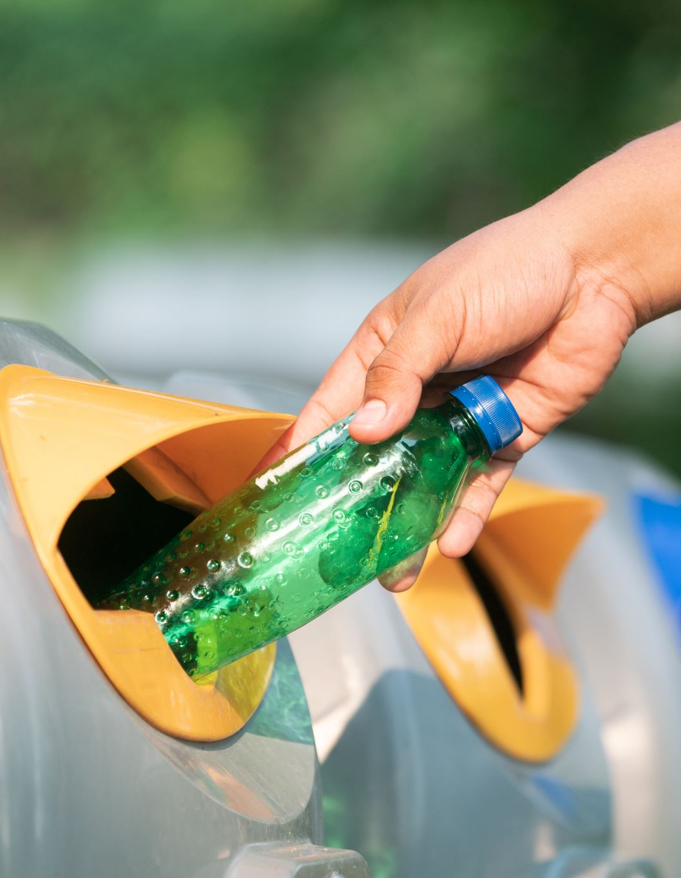
Waste Management Practices: Recycling Rates and Landfill Usage
Effective waste management practices play a crucial role in minimizing environmental impacts, conserving resources, and promoting sustainability. Monitoring recycling rates and landfill usage provides valuable insights into the effectiveness of waste management strategies and the progress towards achieving waste reduction goals.

Slide 40

Recycling Rates:
Measurement and Monitoring:
Recycling rates are measured as the percentage of waste diverted from landfill disposal through recycling, composting, and other diversion methods.
Municipalities and waste management agencies track recycling rates to assess the success of recycling programs, evaluate recycling infrastructure investments, and identify opportunities for improvement.
Factors Influencing Recycling Rates:
Infrastructure: Adequate recycling infrastructure, including recycling centers, material recovery facilities (MRFs), and curbside collection programs, facilitates higher recycling rates by providing convenient and accessible recycling options.
Education and Outreach: Public education campaigns, recycling awareness programs, and community engagement initiatives play a critical role in promoting recycling behaviors and increasing participation rates.
Economic Incentives: Financial incentives such as deposit-refund systems, pay-as-you-throw programs, and recycling rebates incentivize individuals and businesses to recycle more and reduce waste generation.
Benefits of Recycling:
Resource Conservation: Recycling conserves natural resources, reduces the need for raw material extraction, and lowers energy consumption associated with manufacturing processes.
Environmental Protection: Recycling reduces greenhouse gas emissions, minimizes air and water pollution, and helps mitigate the environmental impacts of waste disposal in landfills.
Economic Opportunities: Recycling generates economic benefits through job creation, revenue generation from recycled materials, and cost savings associated with reduced waste disposal fees.

Slide 41
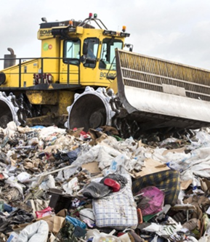
Landfill Usage:
Landfill Capacity and Utilization:
Landfills are engineered disposal facilities designed to safely contain and manage solid waste, but limited landfill capacity poses challenges for long-term waste management.
Monitoring landfill usage involves tracking landfill fill rates, remaining capacity, and disposal trends to inform waste management planning and decision-making.
Landfill Diversion Strategies:
Waste Reduction: Implementing waste reduction strategies such as source reduction, product redesign, and reuse initiatives minimizes the volume of waste entering landfills and extends landfill lifespan.
Alternative Disposal Methods: Exploring alternative disposal methods such as waste-to-energy facilities, anaerobic digestion, and incineration can divert waste from landfills and recover energy or valuable resources from waste streams.
Environmental Impacts:
Landfill Gas Emissions: Landfills emit methane, a potent greenhouse gas, and other air pollutants as organic waste decomposes anaerobically. Effective landfill gas capture and management systems mitigate these emissions and reduce environmental impacts.
Leachate Management: Landfills generate leachate, a liquid by-product of waste decomposition that can contaminate soil and groundwater if not properly managed. Landfill liners, leachate collection systems, and leachate treatment facilities help prevent environmental contamination and protect public health.
This Photo by Unknown author is licensed under CC BY-SA.

Slide 42

Strategies to Reduce and Reuse Municipal Solid Waste
Source Reduction: Encourage minimal packaging, promote reusable products, and advocate for eco-friendly design.
Composting Organic Waste: Establish community composting programs and educate on proper composting techniques.
Material Reuse and Repurposing: Create reuse centers, organize repair events, and encourage creative upcycling.
Extended Producer Responsibility (EPR): Advocate for manufacturer accountability and product stewardship initiatives.
Community Education: Conduct awareness campaigns and provide resources on waste reduction and responsible consumption.
Circular Economy Initiatives: Support circular economy principles through product leasing, sharing platforms, and remanufacturing.

Slide 43
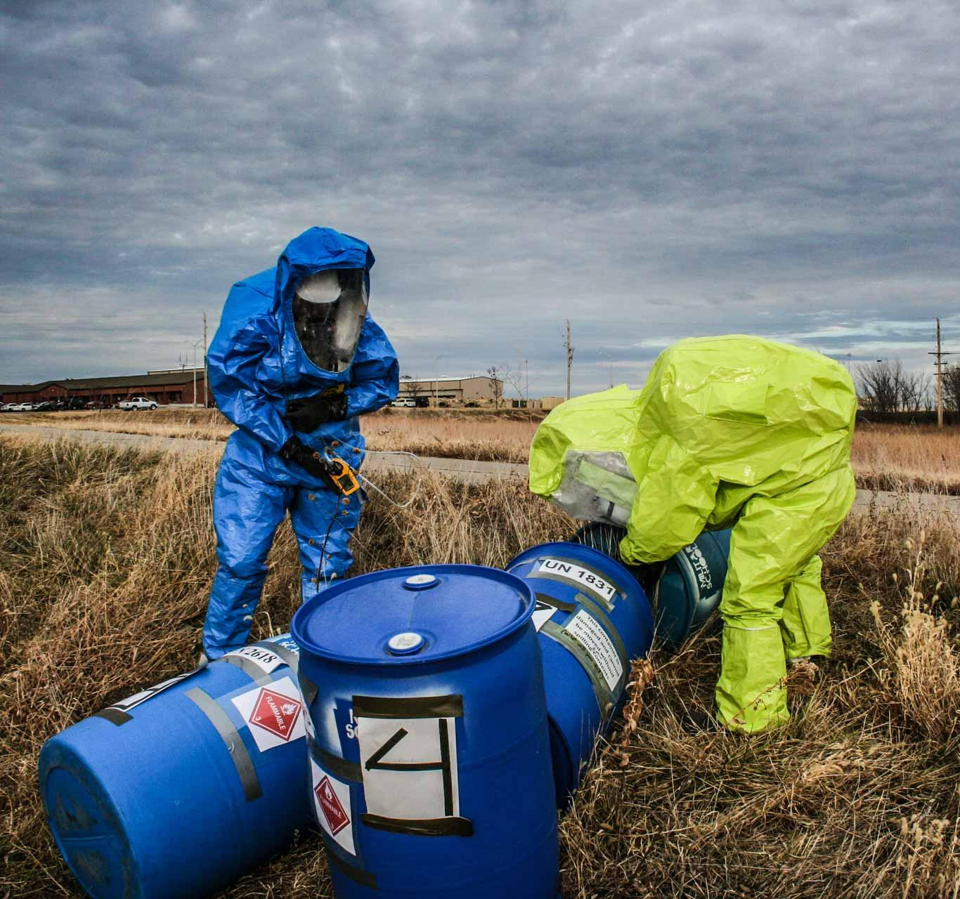
Hazardous Waste
Definition: Hazardous waste refers to discarded materials that pose substantial or potential threats to public health or the environment due to their chemical, physical, or biological properties.
Characteristics: Hazardous wastes exhibit one or more of the following characteristics: ignitability, corrosivity, reactivity, or toxicity.
Sources: Common sources of hazardous waste include industrial processes, manufacturing activities, chemical production, healthcare facilities, and households.
Examples: Hazardous waste examples include solvents, paints, pesticides, batteries, electronic waste (e-waste), pharmaceuticals, and contaminated materials.
Management: Hazardous waste management involves proper handling, storage, transportation, treatment, and disposal to minimize risks to human health and the environment.
Regulations: Hazardous waste is regulated by government agencies such as the Environmental Protection Agency (EPA) in the United States, which sets standards for waste management practices and oversees compliance with regulations.
Challenges: Challenges associated with hazardous waste management include ensuring proper disposal, preventing contamination of soil and water, addressing legacy waste sites, and managing emerging contaminants.
Solutions: Effective hazardous waste management solutions include pollution prevention, recycling, treatment technologies, hazardous waste minimization, and remediation of contaminated sites.

Slide 44
Understanding Transboundary Air Pollution
Cross-Border Impacts Data:
Regional Effects: Air pollution from one country can have significant impacts on air quality, public health, ecosystems, and climate in neighboring regions.
Collaborative Initiatives Data:
International Agreements: Various international agreements and collaborative initiatives aim to address transboundary air pollution, fostering cooperation among nations to mitigate its effects.
Diplomacy in Environmental Protection:
Successes: Diplomatic efforts have led to successful agreements and protocols for managing transboundary air pollution, improving air quality and protecting human health.
Challenges: However, challenges persist in achieving global cooperation due to differing national interests, political tensions, and enforcement issues.

Slide 45
Regional Effects and Global Cooperation
Cross-Border Impacts Data:
Health Impacts: Transboundary air pollution contributes to respiratory diseases, cardiovascular problems, and premature deaths, particularly in densely populated areas.
Environmental Degradation: Pollution deposition can harm ecosystems, soil quality, water bodies, and biodiversity, affecting agriculture, wildlife, and natural habitats.
Collaborative Initiatives Data:
International Cooperation: Collaborative efforts include information sharing, technology transfer, emission reduction targets, and joint monitoring and research projects.
Challenges: Despite progress, challenges such as inadequate funding, limited enforcement mechanisms, and disparities in regulatory standards hinder effective global cooperation in addressing transboundary air pollution.

Slide 46
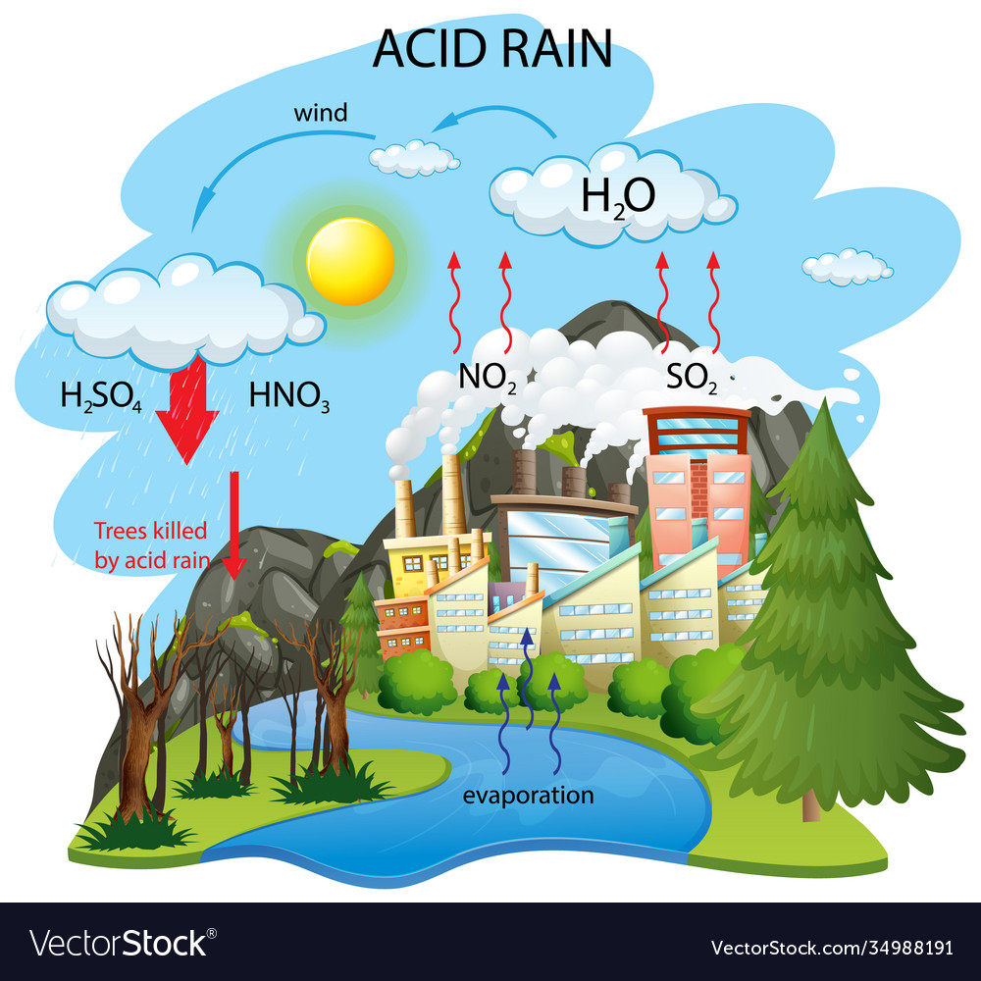
Acid Rain Overview
Introduction to Acid Rain:
Acid rain is precipitation (rain, snow, fog) with elevated acidity levels, primarily caused by emissions of sulfur dioxide (SO2) and nitrogen oxides (NOx) into the atmosphere.
Causes and Consequences Data:
Emission Levels: High levels of sulfur dioxide and nitrogen oxides from human activities such as burning fossil fuels, industrial processes, and transportation contribute to the formation of acid rain.
Consequences: Acid rain damages ecosystems, corrodes buildings and infrastructure, harms aquatic life, and affects human health.

Slide 47

Impact and Interventions
Acidification Effects on Soil and Water Data:
Soil Acidification: Acid rain lowers soil pH levels, leaches nutrients, and damages plant roots, impacting agricultural productivity and soil fertility.
Water Acidification: Acid rain acidifies freshwater bodies, lakes, and streams, endangering aquatic life and disrupting aquatic ecosystems.
Technological Interventions:
Innovations: Technologies such as flue gas desulfurization (FGD), selective catalytic reduction (SCR), and low-emission vehicles help reduce sulfur dioxide and nitrogen oxide emissions, mitigating acid rain effects.
Sustainable Practices: Implementing renewable energy sources, promoting energy efficiency, and adopting cleaner production methods contribute to reducing air pollution and combating acid rain.

Slide 48
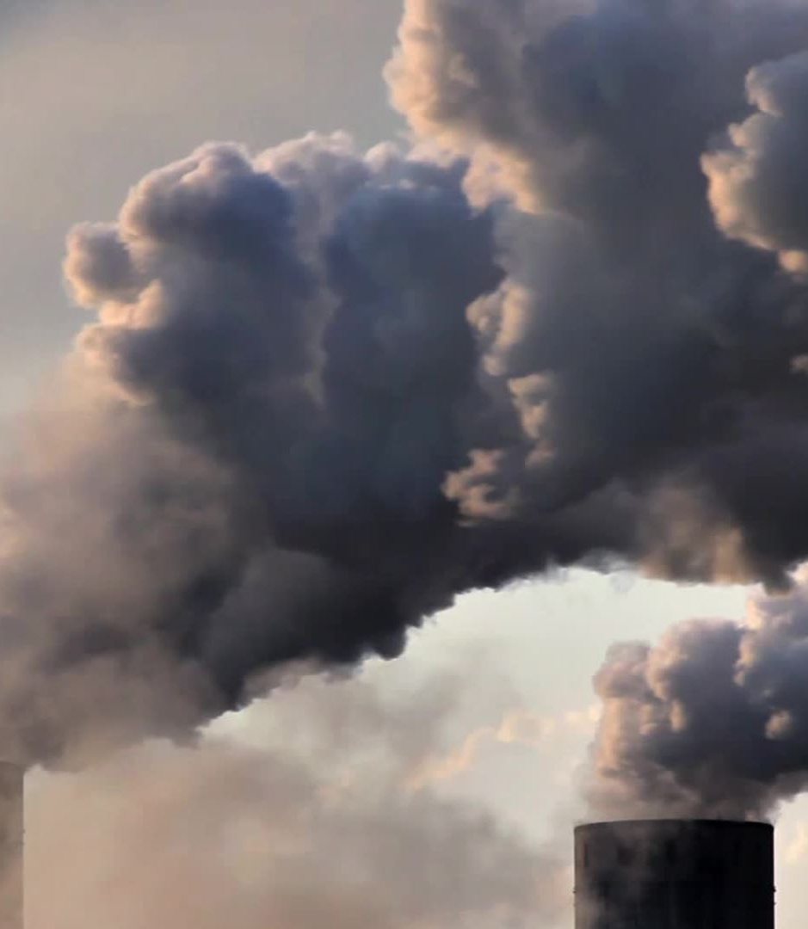
Understanding Smog
Introduction to Smog:
Smog is a type of air pollution characterized by a mixture of smoke and fog, often observed in urban areas with high levels of air pollution.
Formation and Types Data:
Factors: Smog formation is primarily influenced by vehicular emissions, industrial activities, and atmospheric conditions such as temperature inversions and stagnant air masses.
Types: There are two main types of smog: "classic" smog (resulting from industrial emissions and fog) and "photochemical" smog (formed by reactions between pollutants and sunlight).

Slide 49
Impact and Solutions
Health and Environmental Impacts Data:
Respiratory Illness Rates: Smog exacerbates respiratory conditions such as asthma, bronchitis, and lung infections, leading to increased hospitalizations and mortality rates.
Visibility Data: Smog reduces visibility, posing risks to road safety, aviation, and outdoor activities, while also affecting scenic views and tourism.
Urban Greening Initiatives:
Nature-Based Solutions: Urban greening initiatives, including tree planting, green roofs, and green infrastructure, help absorb air pollutants, mitigate heat island effects, and improve air quality.
Benefits: Enhancing urban green spaces not only combats smog but also promotes physical and mental well-being, biodiversity, and urban resilience to climate change.

Slide 50
Conclusion:
My presentation has explored the multifaceted issue of pollution and its far-reaching effects on our planet and well-being. Pollution poses significant challenges to environmental health, human health, and ecosystem integrity, including air and noise pollution, water, soil, and hazardous waste contamination.
Global statistics on pollution-related health issues and ecosystem degradation underscore the urgency of addressing this pressing environmental concern.
Similarly, noise pollution, water pollution, soil pollution, and municipal solid waste were analyzed, highlighting their respective sources, impacts, and management challenges.
International Cooperation and Solutions: Recognizing the transboundary nature of pollution, collaborative initiatives and international agreements are crucial for addressing pollution's regional and global impacts.
From urban greening initiatives to technological innovations and sustainable practices, there's a wide array of solutions available to combat pollution and promote environmental sustainability.
Call to Action: As stewards of the planet, it's imperative that we take collective action to mitigate pollution and safeguard our natural resources for future generations.

Slide 51

In conclusion, tackling pollution requires a concerted effort at the local, national, and global levels. Let us commit to making environmentally conscious choices and advocating for policies that prioritize planetary health and sustainability. Together, we can build a cleaner, greener future for all.
Thank you.
This Photo by Unknown author is licensed under CC BY-NC-ND.

Slide 52
Thank You
Name: Mohammad Wasi
Sap-Id: 500110709
Roll No: R2142221457
Email ID : Wasi.110709@stu.upes.ac.in
Course: B.Tech CSE AIML
Batch: 8
Submitted to : Balendu Shekher Giri

